Slide 2
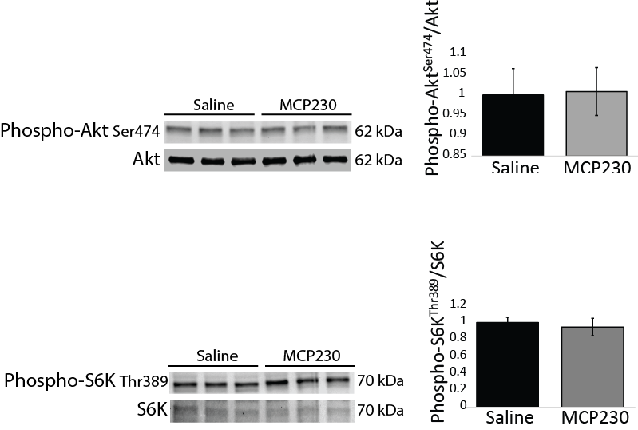
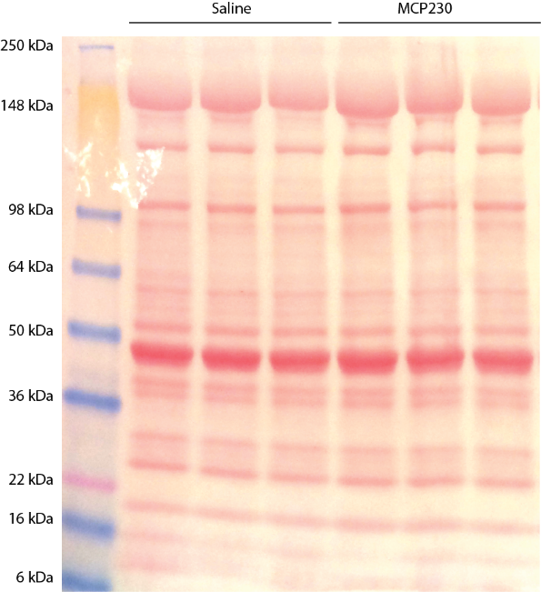
Reviewer #1 “The report did not show any signaling data to support alteration in skeletal muscle metabolism or growth. It will be helpful to include some Western blot on phospho-proteins which are regulated by insulin/IGF1 (such as Akt and p70S6K).“
There are no differences between the two groups.
Quadriceps protein lysates from n=10 mice/group were analyzed. Representative ponceau stain included to show loading conditions were similar.

Slide 3
Reviewer #1 “Does the alterations in ‘hunger hormones’ alter the feeding pattern of mice in response to light-dark cycle? It will be interesting to include this data if it is available from the metabolic cage experiments. For example, did the mice eat more frequently (though cumulative food intake is unaltered)?“
Dave to analyze this data

Slide 4
Reviewer #1 “Despite the profound changes in ghrelin and GLP1 levels, MCP230 mice did not display any alteration in glucose and insulin levels, and the fat mass appear to be mildly affected. The authors should provide an explanation for this in the discussion. “
Need to add a paragraph stating that because the fasting glucose/insulin (and therefore HOMA IR) was unchanged, we decided it was unnecessary to complete an ITT/GTT in these mice.
We should discuss that the mice are generally bigger after exposure to MCP230, rather than fatter per se.
Do Ghrelin/GLP1 affect growth? Possible discussion point.

Slide 5
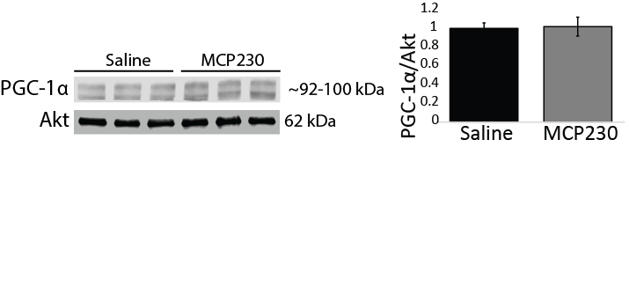
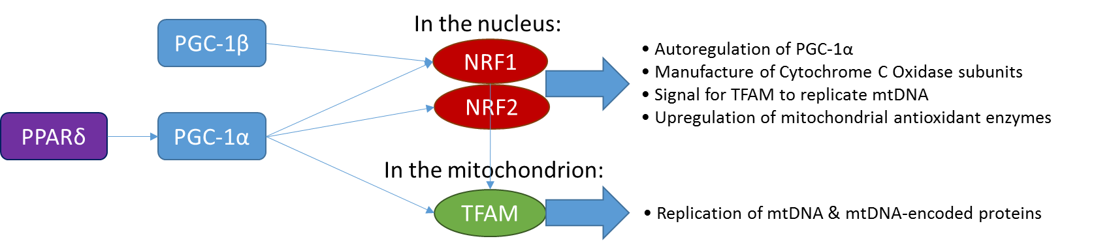
Reviewer #1 “The authors provided data which indicated impaired mitochondrial biogenesis. The authors should provide some data on the upstream regulators of mitochondrial biogenesis such as PGC-1, PPAR or TFAM to strengthen the data.”
p=0.074
p=0.119
This is RT-PCR data (n=7-10/group) & Western blot data (n=8-10/group).
Ppargc1a would not amplify, however, I have PGC-1a protein data, which is not different. Ppargc1b & Ppard are both up in the MCP230 group, although this is not significant. Taken together with a lack of difference in NRF1, NRF2 or TFAM mRNA, this data suggests that the mtDNA reductions are likely due to some kind of damage (possibly oxidative stress), as opposed to transcriptional downregulation.

Slide 6
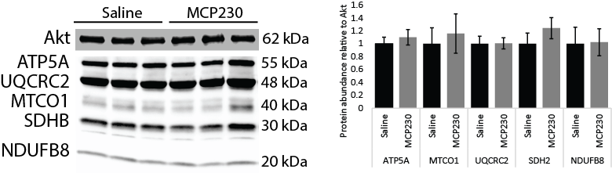
Reviewer #1 “In Figure 5E, quantification of mitochondrial proteins revealed significant changes in NDUFB8 and ATP5A but the bands in the representative Western blot appeared unaltered (visually). Can the authors provide new analyses or blots which are more consistent? What is the significance that only NDUFB8 and ATP5A are elevated at the protein level?”
After repeating the OXPHOS westerns on all the lysates (n=10/group- last time I only ran 5/group), there are no differences in any of the OXPHOS proteins with MCP230 exposure. This further supports our finding that alterations to mtDNA copy number/reduced citrate synthase activity are likely post-translational effects.
Glutathionylation as a potential mechanism?

Slide 7
Reviewer #2 “Functional measurements of insulin sensitivity are needed. A glucose tolerance test and insulin tolerance test would inform on whether the mice are metabolically compromised on the chow fed diet and high fat diet to match up with their increase in weight. Additionally ex vivo measurements of muscle insulin-stimulated glucose uptake would inform on whether the increase in adiposity alters skeletal muscle insulin sensitivity. Also- how long was the fast for Figure 3 data?”
As for reviewer #1. Need to add a paragraph stating that because the fasting glucose/insulin (and therefore HOMA IR) was not different between Saline/MCP230, we decided it was unnecessary to complete an ITT/GTT in these mice.
Again, explicitly stating that these mice were bigger, rather than fatter per se, might help here. I think we already mention in the manuscript that total adiposity (as determined by calculating fat mass as a percent of total body weight) was not different between the two groups.
We have not asked any questions about the insulin sensitivity of the skeletal muscle. Given that HOMA-IR is unchanged, measuring skeletal muscle glucose uptake seems redundant.
The fast for Figure 3 was overnight. This is already mentioned in the methods section.

Slide 8
Reviewer #2 “It is unclear why the metabolic cage data is in chow fed mice while the mitochondrial experiments are in the HFD mice? It is currently inappropriate to try and explain the HFD mice skeletal muscle mitochondrial data with regards to the metabolic cage data. These seem to be completely different experimental groups and because of this, the proposed mechanisms are not supported by the data presented. ”
We thought we had the CLAMS data for the mice post-HFD, but now we are not so sure. We need to look through dates to see if this data is available. If so, Dave to analyze it.

Slide 9
Reviewer #2 “It is unclear why only VO2 is provided to explain energy expenditure. Please provide the Kcal data in addition to presenting the units in line 226-228. Also – considering energy expenditure is lower, analysis of uncoupling proteins in skeletal muscle and adipose depots may help inform on the mechanism.”
The direct relationship between O2 consumption and energy expenditure is well described, therefore we felt it was unnecessary to also give the data in kCal. However, to satisfy this request, Dave will draw a graph with kCal units to include along with the VO2 data.
This is RT-PCR data (n=7-10/group) for uncoupling proteins in skeletal muscle.
UCP1 is barely detectable in skeletal muscle and therefore could not be reliably measured. UCP2 is elevated whereas UCP3 is reduced (although not significantly). Other known uncoupling/thermogenic mechanisms in muscle may also be elevated, arguing against a reduction in uncoupling as driving the lower energy expenditure in the MCP230 exposed mice.
In eWAT, Ucp1 is reduced in the MCP230-exposed mice, although this is not quite significnant (p=0.08, n=8-13)
p=0.015
p=0.221
p=0.004

Slide 10
Reviewer #2 “Based on the RER data – it seems that the Cabosil control alters energy metabolism independent of the EPFR as the Cabosil group and the MCP230 group both show increases in fat oxidation (or decreases in carbohydrate oxidation) comparable to saline. Thus, it is pertinent to ensure that the Cabosil is not a confounding variable. Also, why is the VO2 graph and the ambulatory movement graph labelled as both Saline and Cabosil while the RER is labeled as 3 groups? It is unclear what is happening here ”
I am pretty sure we discussed this in the text of the manuscript. Cabosil only had an effect on RER, which is why all the other data is presented as Saline/MCP230, or Saline & Cabosil/MCP230.

Slide 11
Reviewer #2 “The fact that mitochondrial protein expression does not correlate with citrate synthase activity is interestingly and should be further addressed. Functional experiments in freshly isolated mitochondrial or permeabilized myofibres would be important to investigate the functional significance of these differences.”
It is not possible to assess mitochondrial activity in freshly isolated mitochondria or permeabilized fibers without repeating the entire study.
A possible explanation for the reduction in mtDNA/ reduced mitochondrial activity is glutathionlyation induced by oxidative stress. CI and CV of the respiratory chain and many enzymes of the TCA cycle (including citrate synthase) can by glutathionylated in order to inhibit activity (and thus reduce endogenous ROS production). Need to find some good references for this.

Slide 12
Reviewer #2 “Figure 3A y-axis is unusual. What is the dose of EPFR compared to how much a human would be exposed to?”
Figure 3A y-axis is normal (mg/dL), although not metric system (mmol/L).
Sri/Steph, can you please write a paragraph for the reviewer about the EPFR dose and how the dose used in our study compares to average human exposure?

Slide 13
Reviewer #3 “No functional data provided for the mitochondria (i.e. mitochondrial respiration). When considering the defined hypotheses it would seem these measurements are necessary.”
We provide citrate synthase activity, which is functional. It is not possible for us to complete respirometry experiments without repeating the study in an entirely new cohort of mice.

Slide 14
Reviewer #3 “In the same line of thinking, the discussion provides extended discussions on oxidative stress, yet the submission does not provide a single measure of oxidative stress.”
This is RT-PCR data (n=7-10/group) for genes important for defending against oxidative stress. Most of these genes are altered with MCP230 exposure, suggesting there is oxidative stress in the muscle.
We are looking into measuring glutathionylation in the protein lysates to help support the oxidative stress/reduced mitochondrial function hypothesis.
p=0.0009
p=0.0005
p=0.005
p=0.028
p=0.132
p=0.013
p=0.042
p=0.015

Slide 15
Reviewer #3 “Also, there is a disconnect between the mtDNA results and the results obtained using the OXPHOS antibody with no clear explanation over why this may have occurred. Functional data or EM imaging likely would clear this up.”
Our newly included transcriptional data (see slide for reviewer #1) indicates that the reduction in mtDNA is downstream of mitochondrial biogenesis signaling and we propose that there are posttranslational modifications that cause the reduced citrate synthase activity (such as glutathionylation) and/or damage to the mtDNA (such as from oxidative stress).

Slide 16
Reviewer #3 “Providing some sort of intervention that targets the skeletal muscle mitochondria to prevent the overall phenotype induced by the EPFR would significantly strengthen the study.”
We are already underway (kind of) using a SOD2 TG mouse model to address this question. However, it is beyond the scope of the current paper.

Slide 17
Reviewer #3 “Finally, the purpose of the idea was to determine if the animals develop a form of metabolic disease after the EPFR exposure. Thus the authors provided the animals with a HFD, however based on the way the data are presented it is challenging to determine if the HFD actually had an effect. Specifically, ther eis no attempt to determine if the mice develop any sort of glucose intolerance or insulin intolerance while on the HFD.”
Refer to previous slides re. no difference in fasting glucose/insulin (and therefore HOMA-IR). The purpose of the study was to determine if the particulate worsened the obesity phenotype.

